Slide 1
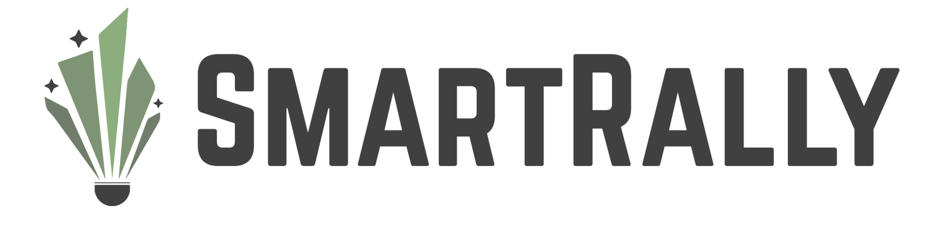
May 21, 2025
AI Approach to Coaching Badminton Strategy with Mobile App
Computer Systems Lab
2024-2025
İpek Sayar, Jacob Dipasupil

Slide 2
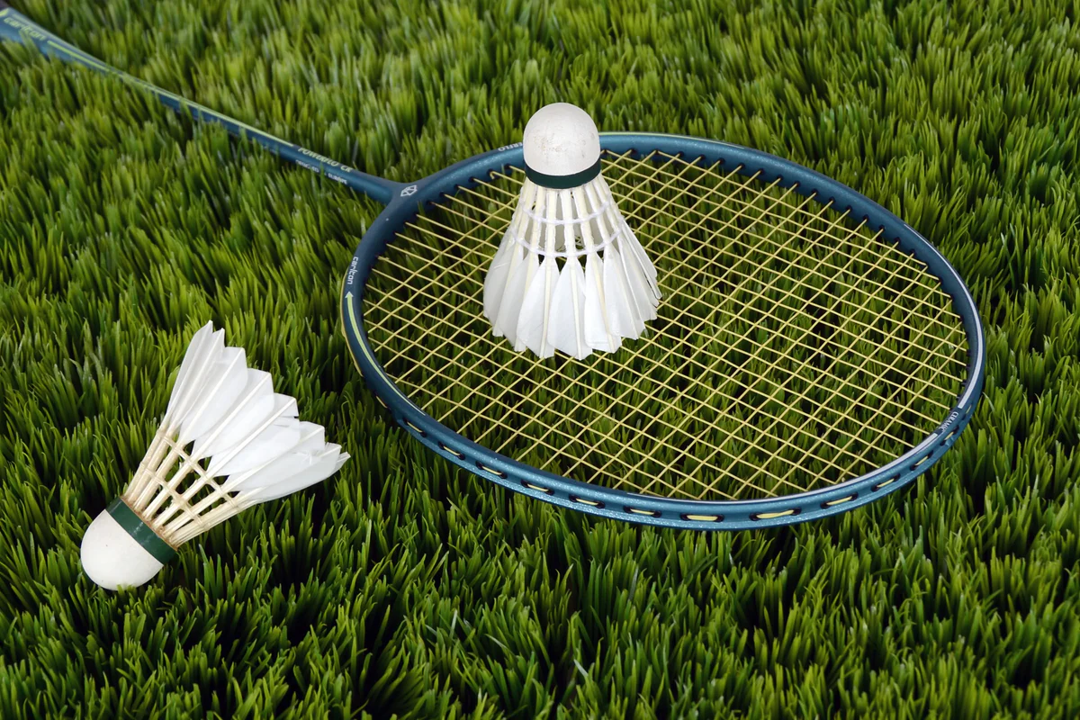
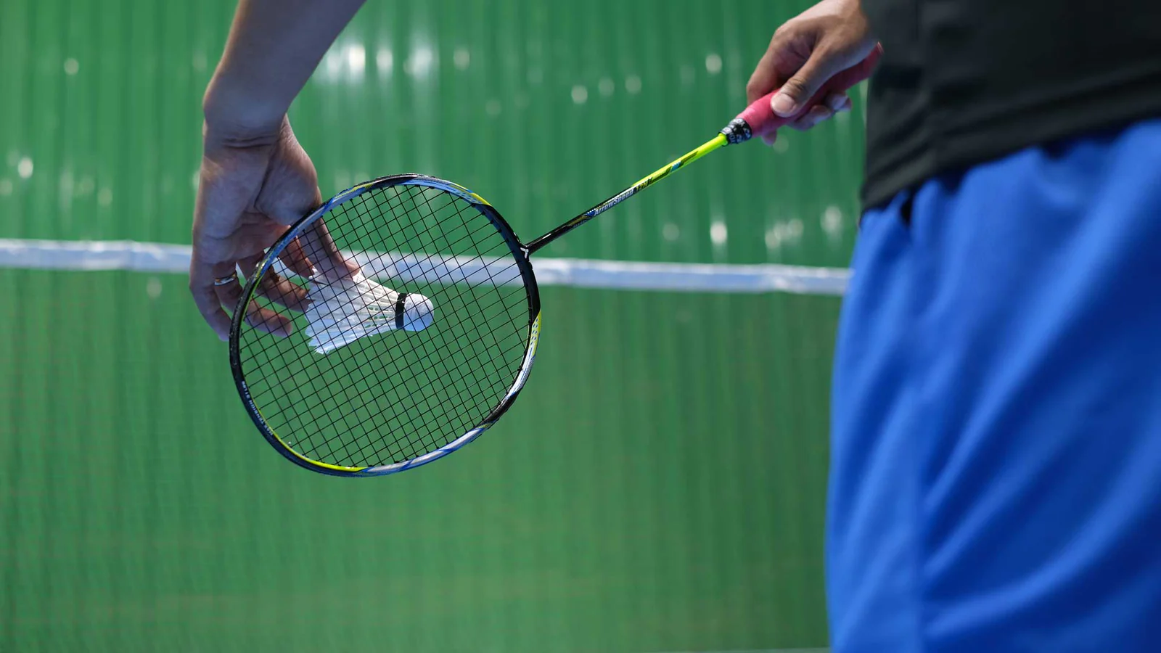
Problem
Popularity
Availability
Cost
No Olympic medals
“Backyard sport”
Majority of badminton clubs are located in California [1]
Only one club in VA with dedicated badminton facilities [1]
Not accessible depending on location
Badminton coaching costs around $100 per hour
Not accessible to lower income families
Notes:
IPEK Badminton isnt popular in the US. Its one of the only sports that we have never won any type of olympic medal in. The main reason for this is because many of us consider it to be a “backyard sport”, a sport thats meant to be played casually, not professionally. Both Jacob and I were introduced to this sport through a school pe class and soon became obsessed with it. However, when looking for opportunities to improve, we came across the unfortunate truth: almost all of the badminton clubs are located all the way in california, with there only being one here in virginia with proper facilities. Additionally, i come from a low income family, there is no way we could afford training that costs around $100 per hour and thats excluding the price of the equipment you need. Due to all of this, Jacob and I have come up with a possible solution for both ourselves and others in the US who are facing similar obstacles.

Slide 3
SmartRally
We have developed an AI-powered app for badminton that leverages advanced computer vision and machine learning techniques to enhance players' skills by analyzing their strategy to offer personalized feedback.
Novelty
Pose recognition
Next Best Move Algorithm
Mobile App
We leverage YOLOv11 for object detection, OpenPose for player detection and joint recognition, TrackNet for shuttlecock tracking, and SlowFast for pose classification.
Notes:
For our project, we introduce SmartRally. Leveraging advanced computer vision and machine learning techniques, we developed an AI-powered app to provide personalized feedback for badminton players.
Our main algorithm, Next Best Move, takes a video input and uses temporal segmentation with pose recognition to analyze the user’s strategy.
The model will be accessible through a mobile app, allowing users anywhere to benefit from SmartRally’s advice.

Slide 4
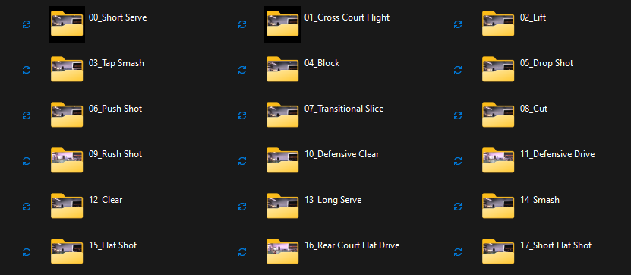
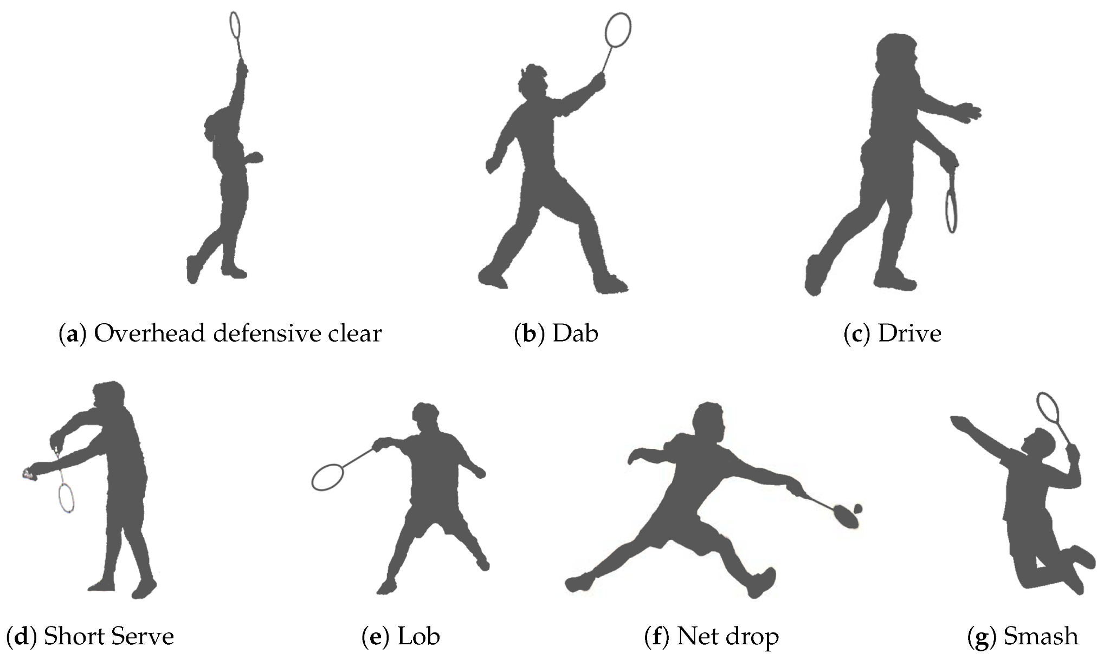
Datasets
VideoBadminton [2]
ShuttleSet [4]
Clean, high quality footage of badminton form and technique.
18 categories of badminton actions
7,822 clips spanning 145 minutes of self-recorded footage
Annotated stroke-level records from matches from 27 top-ranking men’s and women’s singles players
Preprocessed: Only kept five key features — shot, hit_area (0–15), land_area (0–15), player_location_area (0–8), and opponent_location_area (0–8) — to use as input for the NBM algorithm.
Notes:
The VideoBadminton dataset is a clean, high quality dataset consisting of around 7800 clips of 18 different badminton actions, called strokes. The VideoBadminton dataset is used to train a SlowFast model which we use to classify each stroke performed in the videos analyzed by SmartRally.
Annotated stroke-level records from top-ranking singles matches for both men and women
Preprocessed: Only kept five key features — shot, hit_area (0–15), land_area (0–15), player_location_area (0–8), and opponent_location_area (0–8) — to use as input for the NBM algorithm.

Slide 5
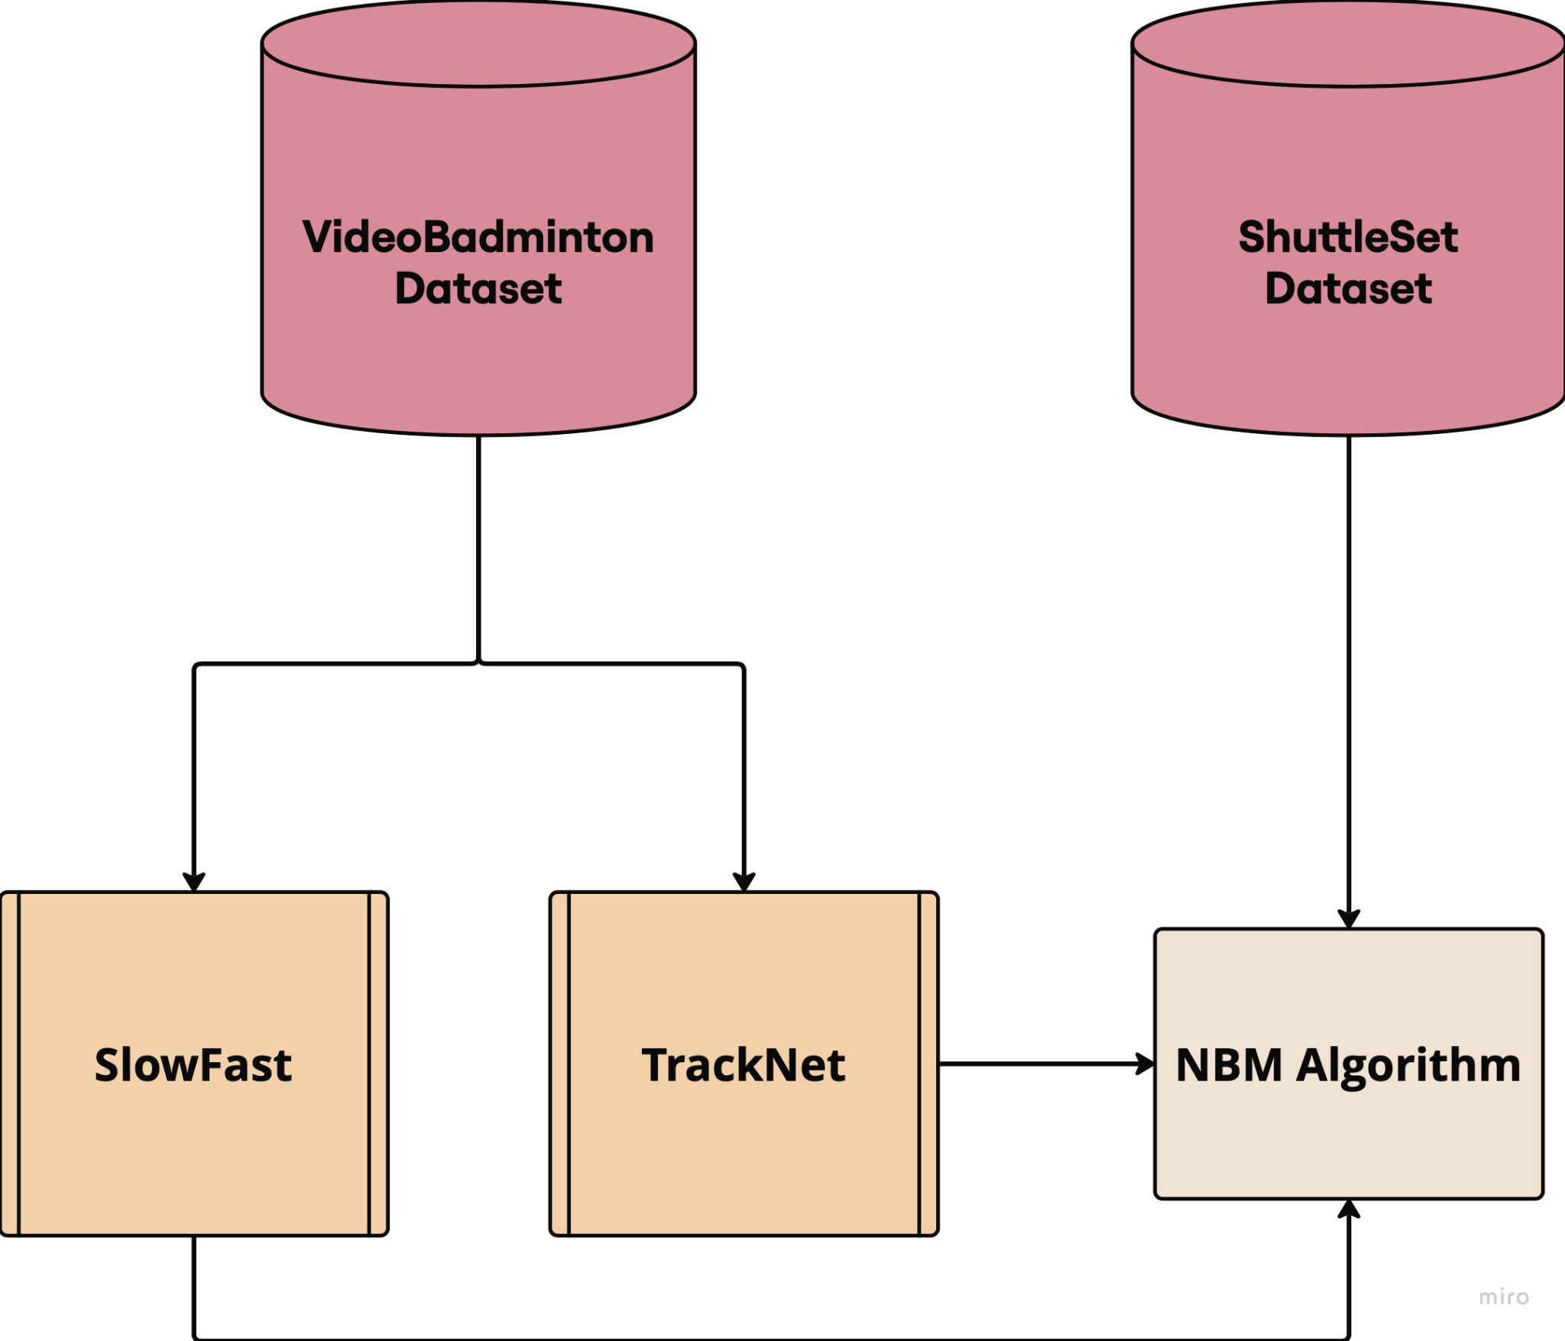
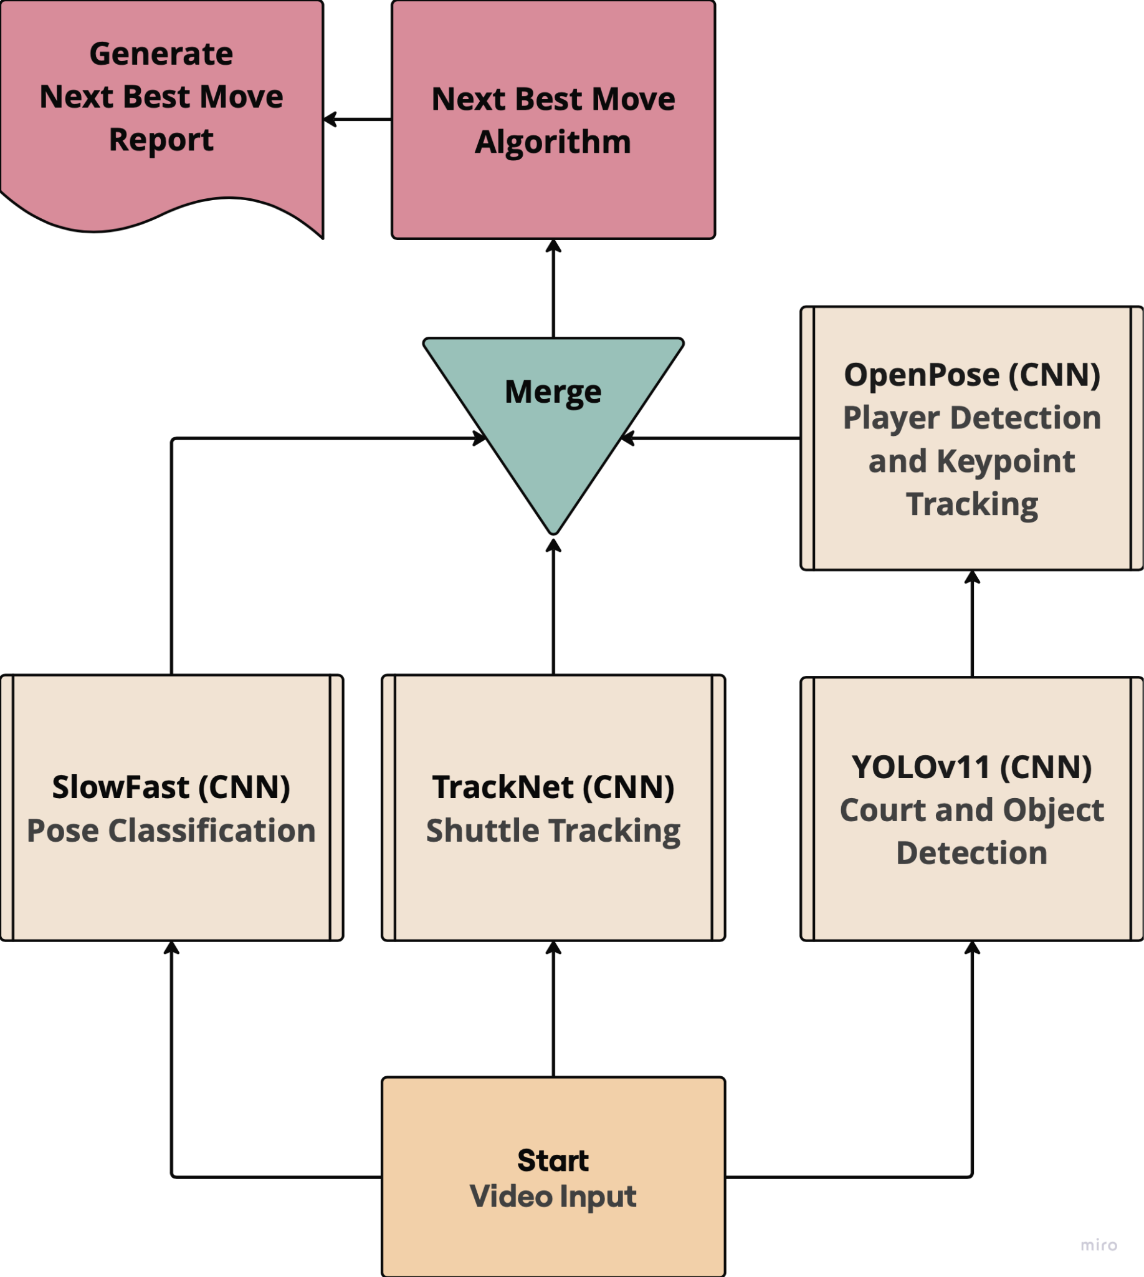
Systems Architecture
Training
Model Structure
Notes:
JACOB We will later talk about each of these in more detail, however for a basic overview,
TrackNet is used to track the trajectory of the birdies and generate heatmaps for their landing locations
YOLOv11 is used for birdie, court detection.
Through YOLOv11’s OpenPose we can also engage in player detection and collect data on their keypoints
SlowFast is used for pose classification

Slide 6
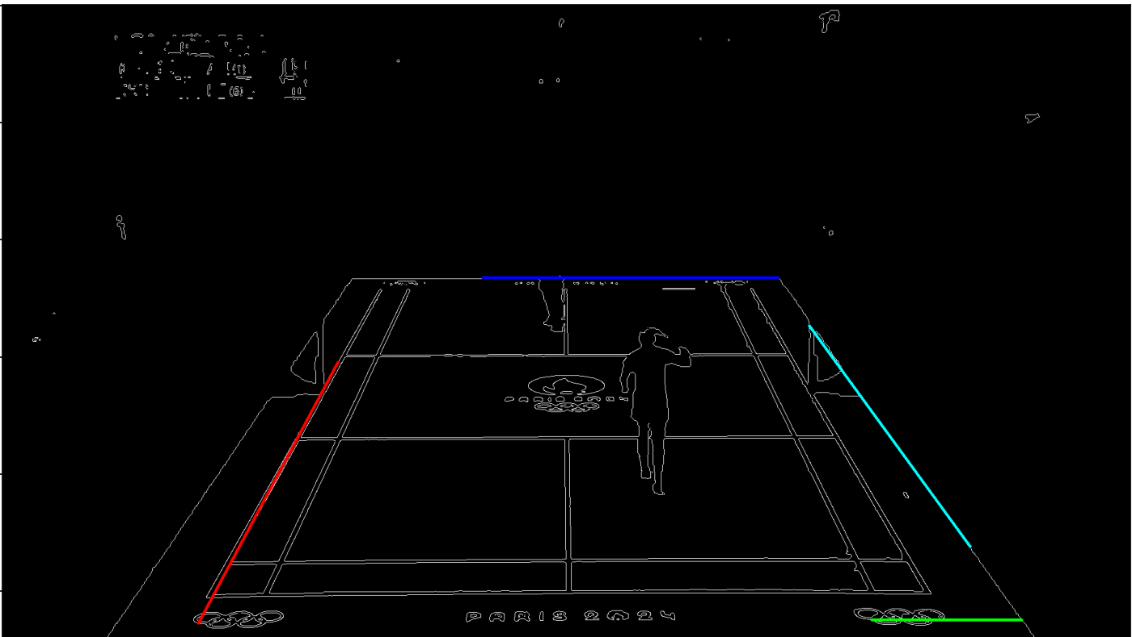
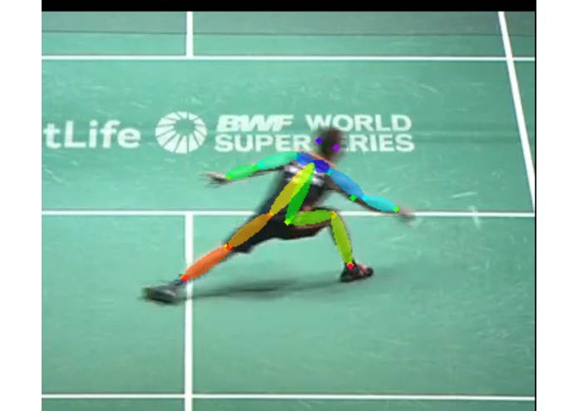
Player Tracking
Each video is split into frames (10-15 frames per second).
Canny edge detection highlights the sharp edges of the court.
Hough Line Transform detects straight lines from the edges to define the court’s boundaries and extract coordinates.
YOLOv11’s OpenPose processes each frame to detect people and their keypoints.
Using the court corner coordinates and a y-buffer, we save the keypoints of the players on the court.
OpenCV is used to highlight key points with red circles.
By focusing on the last two keypoints (the feet), we assign each player a number (0-8) based on which section of the court they are in.
Hough Line Transform
Section 4
Notes:
IPEK
Each video is split into frames (10-15 frames per second).
Canny edge detection highlights the sharp edges of the court. Hough Line Transform detects straight lines from the edges to define the court’s boundaries and extract coordinates. YOLOv11’s OpenPose processes each frame to detect players and their key joints. Using the court corner coordinates and a y-buffer, we isolate players on the court. OpenCV is used to highlight key points (such as joints) with red circles. By focusing on the last two keypoints (the feet), we assign each player a number (0-8) based on which section of the court they occupy.

Slide 7
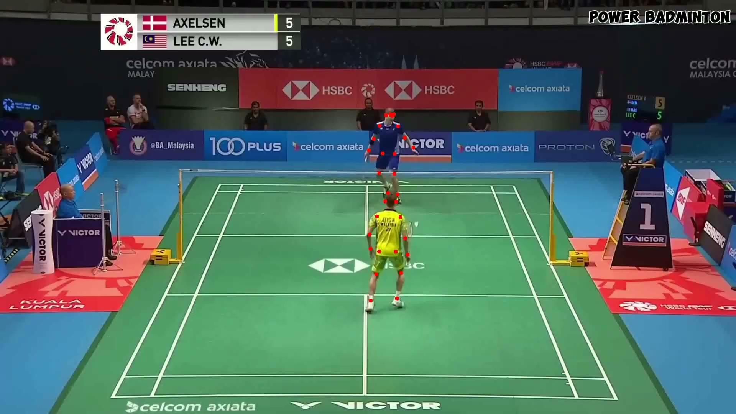
OpenPose Demo
Notes:
IPEK
Here is a video of this being done for a 20 sec clip of a badminton match recently played in the 2024 olympics

Slide 8
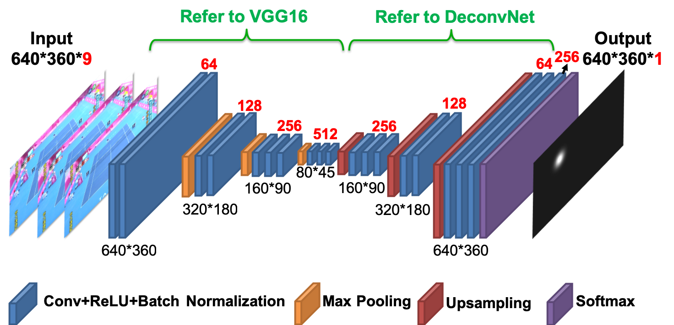
TrackNet [3]
Notes:
TrackNet is a deep learning network for high-speed tiny object tracking. TrackNet could take multiple consecutive frames as input, and model will learn object and trajectory tracking to enhance positioning capabilities.
The structure of TrackNet consists of VGG16, a sixteen layer convolutional neural network, and DeconvNet which is a deconvolutional network–a CNN but works in reverse
TrackNet will generate gaussian heat map centered on ball to indicate position of the ball. TrackNet is used to detect the trajectory and predict the location of the birdie throughout the match

Slide 9
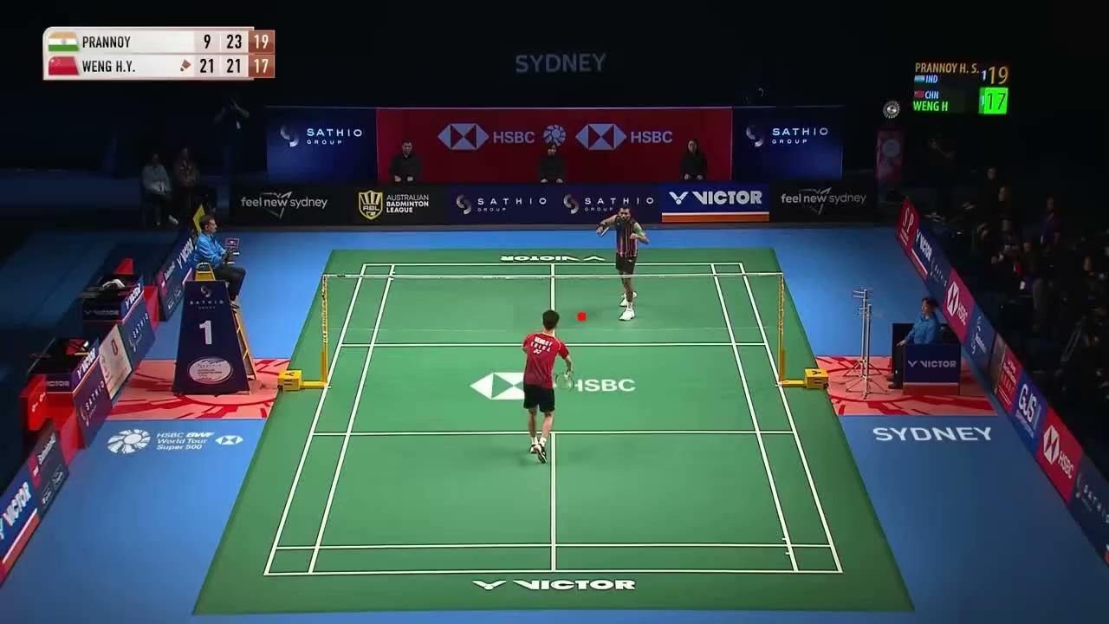
TrackNet Demo
Notes:
Here is a demo of TrackNet in action. The current model we are using is far from perfect. Our TrackNet model sometimes predicts the birdie trajectory going off from the true path, or cannot detect the birdie in some areas–especially near the net. These errors are due to the data we trained our model with. We annotated the VideoBadminton frames using an AI annotating tool on Roboflow, which has only around 70% accuracy, and trained our model on that. However, this will improve over time as we look into better annotation tools.
JACOB

Slide 10
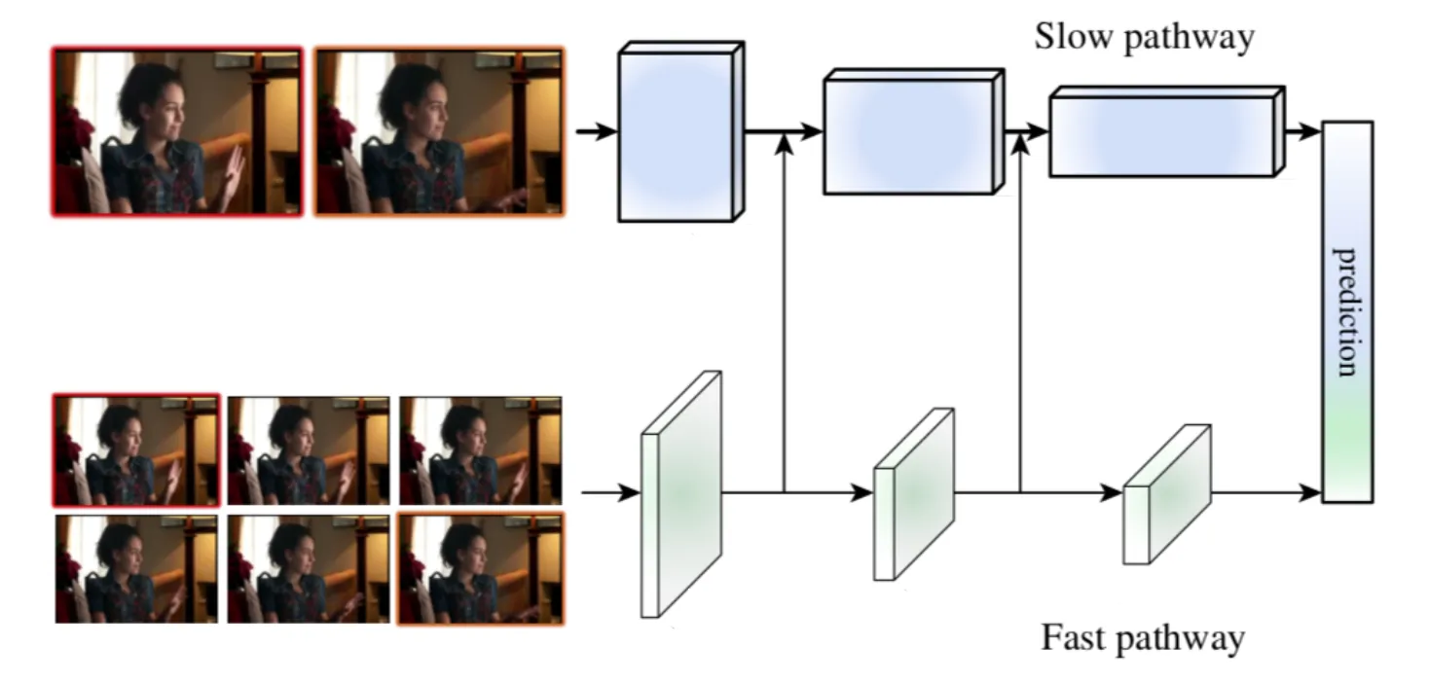
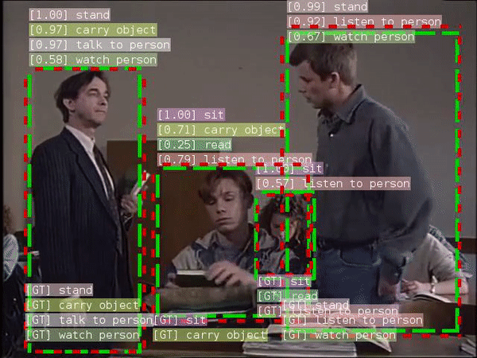
SlowFast [5]
Slow pathway: Slow, high-definition CNN to analyze the static content of a video
Fast pathway: fast, low-definition CNN that analyzes the dynamic content of a video.
Trained on VideoBadminton dataset
Achieved Top-1 accuracy of ~72%
Notes:
https://medium.com/data-science/slowfast-explained-dual-mode-cnn-for-video-understanding-8bf639960256
SlowFast uses a slow, high-definition CNN (slow pathway) to analyze the static content of a video while running in parallel a fast, low-definition CNN (fast pathway) whose goal is to analyze the dynamic content of a video.
Both the Slow and Fast pathways use a 3D ResNet model, capturing several frames at once and running 3D convolution operations on them.
We then trained a SlowFast model on the VideoBadminton dataset and achieved a Top-1 accuracy of around 72%

Slide 11
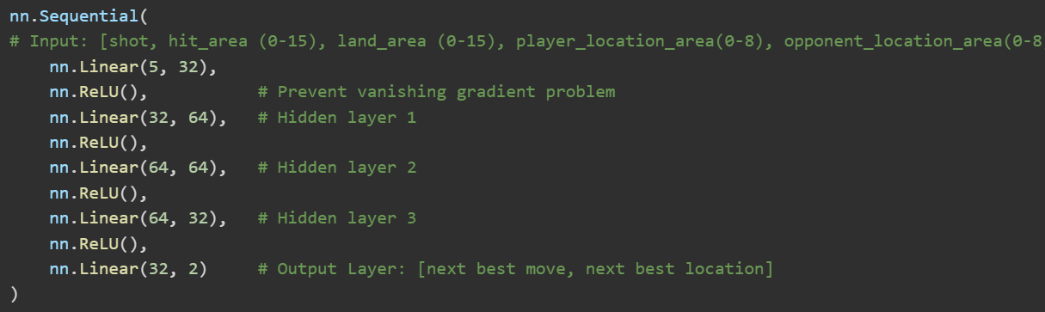
Next Best Move (NBM)
1-2 Hidden Layers → Underfitting
That means the model ends up too simple, it misses the deeper patterns.
>3 Hidden Layers → Overfitting
Memorizes the training set and isn't able to generalize testing set
ReLU helps vanishing gradients
When learning freezes while
the error is still high.
No one absolute best move in every sequence
Model gives statistical best choice
Like a chess engine: guidance, not commands
Notes:
When we built our model, we used a feedforward neural network with an input layer, three hidden layers, and an output layer.
The input layer takes in a 5x1 vector: [Player location, Opponent location, Birdie hit location, Birdie land location, Move the player just played] That’s the full snapshot of a moment in the game.
Then we pass that data through three hidden layers, each with an activation function called ReLU in between.
ReLU helps the model learn faster and more clearly by avoiding something called the vanishing gradient problem, which is when the network learns too slowly or stops improving at all while the error is still high.
We use three hidden layers Because badminton isn't linear. You can't just say “if X, then always Y.”The right move depends on nuanced interactions
We found that 1–2 hidden layers didn’t capture enough. They underfit, meaning the model ends up too simple — it misses the deeper patterns. Beyond three, the model started to overfit, memorizing training data rather than learning how to generalize.
It’s like memorizing homework answers. When the test changes slightly, you're lost.
With 3 layers, the model learns in steps:
Layer 1 understands basic positions and shots
Layer 2 figures out player-shot interactions (like “if opponent is near net and you lift, what happens?”)
Layer 3 maps these insights to smart decisions (clear to backcourt gives best chance of recovery”)
Then we reach the output layer, which produces a 2x1 vector [The move the player should play next,the predicted location where that birdie should land]
Additionally, we know real games don’t have only one perfect answer. So the app doesn’t give the move, it gives the statistically strongest one.
Think of it like a chess engine: the top suggested move isn’t the only good move, but it’s the one that consistently yields the best results over time."

Slide 12

Mobile App Demo
Notes:
DO live demo

Slide 13
Conclusion: Developing Game Sense
Recreate scenarios the app gives you and practice the suggested “next best move”
Re-record and feed videos back into the app to track how your decision-making evolves
Build muscle memory and strategy over time
It's like driving:
New drivers know rules, but not instincts
Real skills come from reacting to live situations
Patterns emerge with repetition
Eventually, you just know the right move
Notes:
After you get your feedback from the app, that’s not the end, that’s where real improvement starts.
What you want to do is go back to the court and recreate the scenarios the app identified.
Say it told you, “In this situation, you should’ve dropped the birdie instead of smashing.” Try that. Play the suggested move. Record the outcome. Then feed that new video back into the app.
Over time, you’ll see if you’re making better decisions, executing more effective plays, and developing real game sense.
It’s kind of like learning to drive.
When you're a beginner, you technically know the rules. You took the test. But the first time you hit traffic, it’s chaos.
You don’t know how to merge in fast-moving lanes, or when a green light’s about to turn yellow, or when a car’s going to brake.
But after a while, you start recognizing patterns:
“Oh, when that car's drifting toward my lane and the light is yellow, I should probably ease off the gas.”
That’s not something you memorized, it’s something you felt through experience.
And it’s the same here. Our app helps you accelerate that learning curve.
You’re not just reacting, you’re understanding the game. Eventually, you won’t even need the app to tell you what to do. You’ll see a pattern and already know the right move.
That’s what we mean by building game sense.

Slide 14
Questions?

Slide 15
References
[1] https://www.worldbadminton.com/whereToPlay/unitedStates/index.html#va
[2] https://arxiv.org/html/2403.12385v1#S3
[3] https://inoliao.github.io/CoachAI/
[4] https://github.com/wywyWang/ShuttleNet
[5] https://github.com/facebookresearch/SlowFast
Notes:
JACOB
Heres our references

